Slide 1
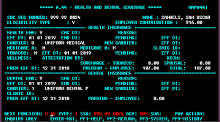

Strategic Vision: Unified Change Management Ecosystem
Legacy Solution
Tactical(Current) Solution
Strategic(Future) Solution
Parts & BOM Releasing & Change Process
Parts & BOM Releasing & Change Process
Parts & BOM Releasing & Change Process
WERS
WERS
2023x On-Premise
2026x On-Premise
Engineering & Manufacturing
ERP
Engineering & Manufacturing
ERP
Engineering & Manufacturing
ERP
SAP4HANA
SAP4HANA
TEAMCENTER
SAP
Finance/Cost Change
Finance/Cost Change
Finance/Cost Change
NGR(REDBOOK)
NGR(REDBOOK)
CRIDX
CRIDX
ED&T Sheet
ED&T Sheet
RADS
RADS
Change Management
Change Management
EDP4E
Change Management
iCreate
eTracker/PACN
Celonis
Celonis-Dashboarding & Tracking- Program
2023x On-Premise
iCreate
eTracker/PACN

